Slide 1


Nevada School Leaders School-Based Mental Health
Institute
2025

Slide 2

BREAKFAST
& INTRODUCTION

Slide 3
Morning Afternoon
8:00-8:30 - Breakfast and Intro
9:00-9:40 School Counseling
9:40-10:20 School Psychology
10:20- 11:05 School Social Work
11:05-12:00 School Resource Officer
12-12:30 Lunch
12:30 - 1:30 Focus Groups
1:30 - 3:00 Apply Learning
3:00-3:30 Tips & Takeaways

Slide 4
Pre - Evaluation
Post-Evaluation
CEUs
Advarra - $ Payment
Consent for Research

Slide 5
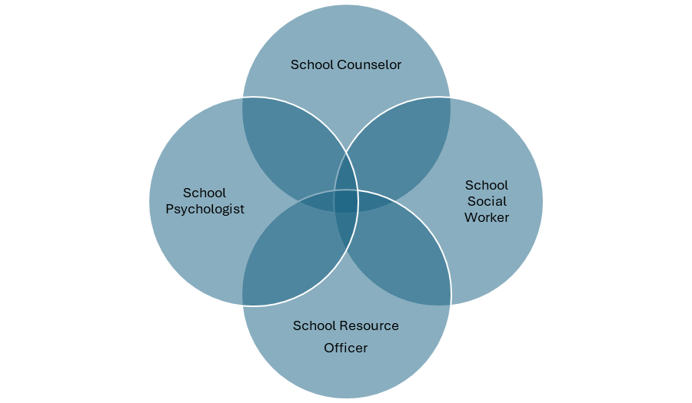
No Single Person
No Single
Position
Or, Teamwork Makes the Dream Work

Slide 6
MENTAL HEALTH PROFESSIONALS IN THE SCHOOLS

Slide 7


School Counseling
(Jungnam Kim & Chris Wood)
Jungnam Kim, Ph.D. and Dr. Wood are associate professors of Counselor Education at UNLV.
Dr. Kim’s scholarship focus is on facilitating parents’ sense of empowerment, increasing college access and opportunity, and reducing educational barriers for marginalized groups.
Dr. Wood’s scholarship focus is on career development, educationally vulnerable youth, school based mental health services, and Counselor education & supervision.

Slide 8

Bridging the Gap between Academia and Practice
What Do Counselors Really Do?

Slide 9
Dr. Chris Wood & Dr. Jungnam Kim
Department of Counselor Education, School Psychology, and Human Services

Slide 10
Think-Pair-Share
Write a challenge you believe school counselors face (e.g., test coordination, scheduling).
Then, partner up and explore:
  Which of these tasks are appropriate?
  Which reflect role confusion or mission drift?

Slide 11
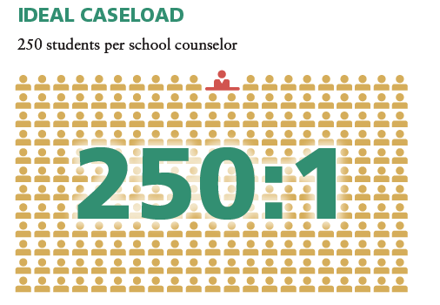
Who are School Counselors?
School counselors are certified/licensed educators who improve student success for ALL students by implementing a comprehensive school counseling program.

Slide 12
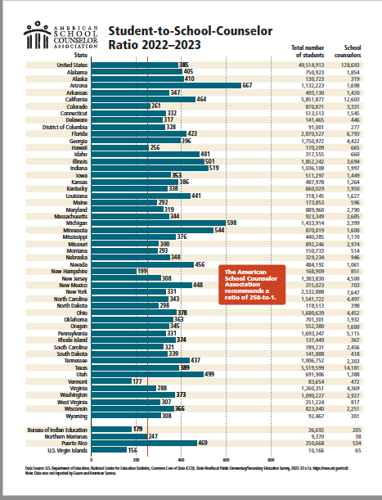

Slide 13
Review the 10 tasks below and choose the 3 you will prioritize. Then, write who/what you must delay or drop
Student in crisis after a fight at home
juniors waiting to talk about FAFSA
Parent asking to reschedule IEP
Teacher upset about a disruptive student
Admin requesting test room setup
Class guidance lesson at 10 a.m.
Email from district needing immediate response
Student sent to office for skipping class
Student club advisor needs SEL event help
First-year teacher requesting behavior plan support

Slide 14
Circle or highlight 3 tasks
Briefly write why you chose those
List who/what will be delayed or dropped

Slide 15
Debrief & Reflection
What did you prioritize and why?
How did it feel to leave something unaddressed?
What is lost when counselors are stretched too thin?
What one change could you make as an administrator to support your counselors?

Slide 16
Counselor Reality Check
1. Provide a set of tasks (or use sticky notes)
2. Participants sort them into two columns:
Appropriate for school counselors
Inappropriate (mission drift)

Slide 17
Appropriate Activities for School Counselors | Inappropriate Activities for School Counselors
Appraisal & advisement for academic planning | Building the master schedule
Academic advising for new students | Coordinating paperwork and data entry of all new students
Presenting school counseling lessons based on the ASCA Student Standards to address students’ developmental needs and needs identified through data | Covering classes when teachers are absent or to create teacher planning time
Consulting with teachers about building classroom connections, effective classroom management and the role of the ASCA Student Standards in student success | Supervising classrooms, common areas, in- school suspension or time-out rooms
Interpreting cognitive, aptitude and achievement tests | Coordinating school/district cognitive, aptitude and achievement testing programs
Analyzing schoolwide and school counseling program data | Serving as a data entry clerk
Analyzing GPAs in relationship to achievement | Computing GPAs
Interpreting student records | Maintaining student records
Protecting student records and information per state and federal regulations | Keeping/filing clerical records
Providing short-term individual and small- group counseling services to students | Providing long-term counseling in schools
Providing counseling to students who are frequently tardy or absent | Signing excuses for students who are tardy or absent
Providing counseling to students who have disciplinary problems | Disciplining students or assigning discipline consequences
Consulting with the school principal to identify and resolve student issues, needs and problems | Assisting with duties in the principal’s office
Advocating for students at individual education plan and 504 meetings, student study teams and school attendance review boards, as necessary | Coordinating schoolwide individual education plans, 504 plans, student study teams, response to intervention plans, MTSS and school attendance review boards

Slide 18
Challenges Counselors Face in Schools
Assigned inappropriate non-counseling tasks (e.g., lunch duty, testing)
High student-to-counselor ratios (exceed ASCA's 250:1 recommendation)
Limited access to student data for proactive planning
Lack of collaboration with school administrators
Burnout from high emotional load and systemic obstacles
Resistance when advocating for equity and systemic change

Slide 19
School Counselors: Then, Now, and Future

Slide 20
History Of School Counseling 1907 - 1958
1907 – Jesse B. Davis, Principal – Central High School, Grand Rapids Michigan
1907 – Frank Parsons – charter for Vocational Bureau of Boston
1908 – ‘Systematic Guidance Program’ - Central High School, Grand Rapids Michigan
1909 - Choosing a Vocation published – Frank Parsons
1952 – American School Counseling Association (ASCA) formed
1957 Sputnik

Slide 21
History Of School Counseling 1958 - 2025
1958 NDEA
1960’s emergence of mental health, person centered counseling – Rogers
1970’s -& 1980’s – Role Conflict. A Nation at Risk, Neglected Majority…
1990 – Comprehensive Guidance Programs That Work, Norm Gysbers
1990’s NCLB Legislation, School Reform Efforts
2001 – Transforming School Counseling Initiative (TSCI)
2003 - American School Counselor Association (ASCA) National Model
2000’s – Common Core State Standards Initiative, ESSA enactment, Multi-Tiered Systems of Support, School Based Mental Health Services, ChatGPT released (2022)

Slide 22
Embrace the Past, Welcome the Future
• Ongoing focus: accountability, advocacy, and holistic development
• Continued evolution expected based on policy, social needs, and research
• Strong emphasis on data use, equity, and mental health
• Counselors must balance direct and indirect services in systemic roles

Slide 23


ASCA National Model®
A Framework for School Counseling Programs
FIFTH EDITION

Slide 24
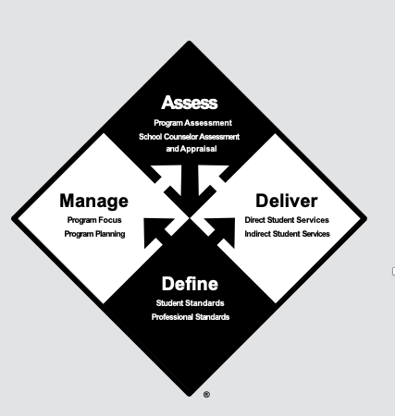


Slide 25
ASCA National Model
“A Framework for School Counseling Programs” outlines the components of a school counseling program integral to the school’s mission.
School counselors design, implement and assess a school counseling program that improves life-readiness and academic success for each and every student.

Slide 26
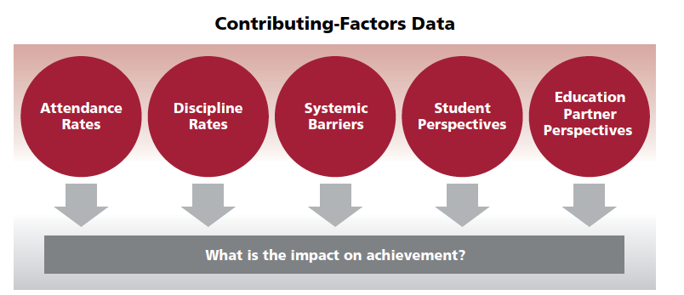

Slide 27
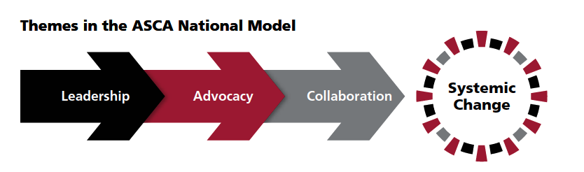

Slide 28
Define
A school counseling program is defined by three sets of standards, which guide school counselors through developing, implementing and assessing a school counseling program.
1 The ASCA School Counselor Professional Standards & Competencies identify the essential knowledge, attitudes and skills school counselors need to implement a school counseling program.
2 The ASCA Ethical Standards for School Counselors identify the principles of ethical behavior necessary for school counselors to maintain the highest standards of integrity, leadership and professionalism.
3 The ASCA Student Standards: Mindsets & Behaviors for Student Success describe the essential knowledge, attitudes and skills students need to achieve academic success, college and career readiness, and social/emotional development. School counselors are committed to helping each and every student attain these mindsets and behaviors to promote positive outcomes.

Slide 29
Mindsets and Behaviors Standards
School counselors design their school counseling program based on their beliefs about students. As outlined in the ASCA Professional Standards & Competencies, school counselors believe:
M 1. Each and every student can learn and can succeed.
M 2. Each and every student should receive a high-quality education.
M 3. Each and every student should have access to a school counseling program.
M 4. Each and every student should graduate from high school prepared for postsecondary opportunities.

Slide 30
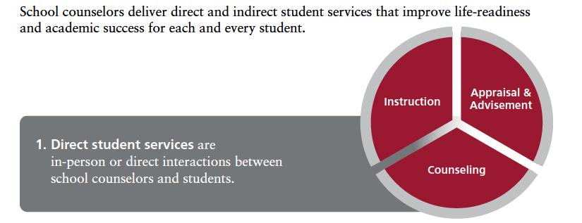
Deliver

Slide 31
Direct Services
Direct Student Service | School Counselors | Setting
Instruction | Enhance student access, life-readiness and academic success through delivery of the ASCA Student Standards. | Classroom, Small Group, Individual (Aligns with MTSS Tier 1 and 2 strategies)
Appraisal & Advisement | Appraisal: Analyze and assess students’ abilities, interests, skills and achievement from test and inventory results. Advisement: Make recommendations based on appraisal of test and inventory results to help students make decisions for their future. | Classroom, Small Group, Individual (Aligns with MTSS Tier 1 and 2 strategies)
Counseling | Provide students with short-term assistance and support based on counseling theories and techniques during times of transition, heightened stress, critical change or other situations impeding academic, career and social/emotional development. | Small Group, Individual (Aligns with MTSS Tier 1 and 2 strategies)

Slide 32
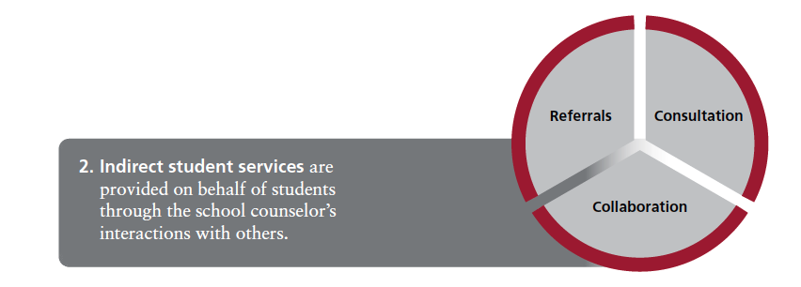
Indirect Student Service | School Counselors | Audience
Referrals | Connect students and families with more intensive resources for life-readiness and academic success. | Students and families (Aligns with MTSS Tier 2 and 3 strategies)
Consultation | Provide information, perspectives, strategies and recommendations to individuals who can support a student’s needs. Seek information on what students might need to address an issue and strategies to enhance life-readiness and improve academic success. | Teachers, administrators, families and education partners (Aligns with MTSS Tier 2 and 3 strategies)
Collaboration | Work with education partners (faculty/staff, parents/guardians, community services/ agencies) on an identified goal for student success, sharing responsibility for identified tasks among cooperating individuals. | Teachers, administrators, families and education partners (Aligns with MTSS Tier 2 and 3 strategies)
Indirect Services

Slide 33
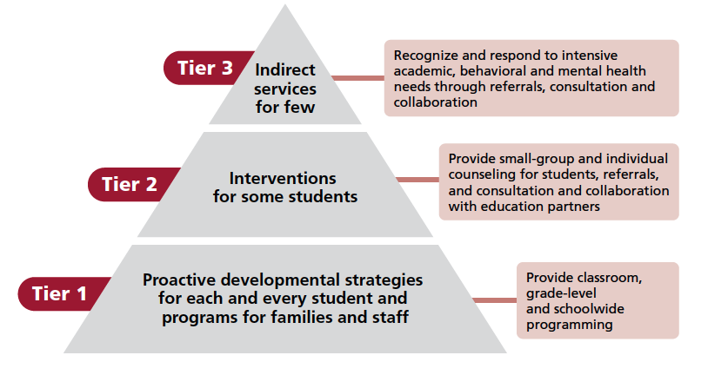
School Counselor Role in MTSS

Slide 34
MTSS for Mental Health Support
3
Individual counseling, Referrals for outside support to mental health agencies, social services, and community resources
2
Small Group counseling (e.g., Check-in/Check-out), Social skill groups, Mentor-based program, Consultations for supporting students with behavior issues, Behavioral contracting
1
Universal screening, Professional development for Staff (e.g., Mental Health awareness, Trauma-informed care), Self-regulation, Classroom Guidance (e.g., Stress management, Anxiety, Depression, Coping skills), Collaboration with mental health providers

Slide 35
Instructions:
Use a live polling tool (e.g., Mentimeter or Slido)
Ask: “What percentage of a counselor’s day should be spent on direct student services?”
Compare responses with ASCA’s recommendation (80%)

Slide 36
Manage
Purpose | Description | How the School Counseling Program Promotes Success for Each and Every Student
Plan how each and every student will learn strategies and skills for student success. | School counselors plan what behaviors each and every student will learn by: Identifying specific standards in the ASCA Student Standards delivery plan that will be delivered in Tier 1 and 2 settings planning how the standards will be delivered using lesson plans and small-group sessions plan using these standards to provide focus for individual sessions with students. | Identifies behaviors standards from the ASCA Student Standards school counselors deliver in classrooms, large groups, small groups and individually to enhance life- readiness for each and every student.
Identify and address achievement gaps. | School counselors identify school counseling data priorities that align with the school improvement plan and create achievement gap plans to address the needs of students who are not reaching achievement goals or benchmarks. | Focuses attention on achievement gaps for students not meeting achievement benchmarks and connects the gaps to contributing factors, such as attendance, discipline and policies/procedures (e.g., patterns in course enrollment or discipline policies)
Plan and monitor time. | Use weekly calendars to prioritize, plan and publicize day-to-day work. Publicize an annual calendar, which includes all major school counseling activities, to students, families and education partners. Monitor use of time. ASCA recommends school counselors spend at least 80% of their time in direct and indirect services to students and 20% or less in program planning and school support. | Communicates all of the school counseling activities delivered to each and every student and documents the school counselor’s appropriate use of time to ensure their ability to address success for each and every student in their caseload.

Slide 37
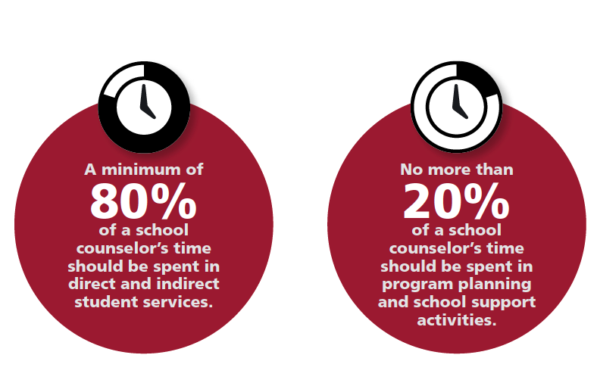
Manage
Purpose | Description | How the School Counseling Program Promotes Success for Each and Every Student
Educate about and advocate for the school counseling program. | Hold the annual administrator conference with the administrator in charge of the school counseling program to educate about the program’s impact and advocate for its organization, goals, plans and use of time. Hold fall and spring advisory council meetings to educate education partners about the program’s impact and advocate for the support and role of the school counselor. Communicate school counseling program information to students and families, and share the program’s impact with decision- makers and other education partners. | Communicates program priorities and plans for each and every student to the administrator in charge of the school counseling program, as well as other education partners. Gives a voice to education partners through dialogue about how the school counseling program addresses success for each and every student

Slide 38
ASSESS
Program Assessment
School Counselor Assessment and Appraisal
Purpose | Description | How the School Counseling Program Promotes Success for Each and Every Student
Assess the school counseling program for alignment with the ASCA National Model® | The School Counseling Program Assessment guides the regular assessment of design and delivery of a school counseling program and its impact on access, life- readiness and academic success. | Research shows that school counseling programs aligned with the ASCA National Model® improve student achievement, attendance and discipline. School counselors implementing these programs have increased job satisfaction and a better understanding of their role in the school’s ecosystem.
Purpose | Description | How it Promotes Success for Each and Every Student
Self-assess your own mindsets and behaviors and formulate an appropriate professional development plan | The ASCA School Counselor Professional Standards & Competencies Assessment is used to self-assess the school counselor’s knowledge, attitudes and skills needed to implement a school counseling program | Continued professional development promotes increased school counseling expertise, leading to improved student outcomes.
Gain feedback on your performance as a school counselor | The ASCA School Counselor Performance Appraisal provides a guide for performance evaluation measured by expectations that are specific to the school counseling profession. | Provides an opportunity for the school counselor to share artifacts of activities implemented to improve student achievement and create systematic change for each and every student.

Slide 39
ASCA NATIONAL MODEL® RESEARCH AND RESOURCES
Effectiveness of School Counseling Research
  ASCA National Model®: What the Research Says
  School Counselors Matter
  Effectiveness Research
  Learn more at schoolcounselor.org/effectiveness
View webinars about the ASCA National Model at: videos.schoolcounselor.org
Download templates at: schoolcounselor.org/templates
Become an ASCA U ASCA National Model® Specialist at: schoolcounselor.org/ASCAU
Become an ASCA-Certified School Counselor®: schoolcounselor.org/ACSC
Learn about the Recognized ASCA Model Program®: schoolcounselor.org/RAMP

Slide 40
Future Steps
“One thing I will do differently after today’s session is…”
Notes:
Participants write on sticky notes or enter into a Padlet

Slide 41


Slide 42
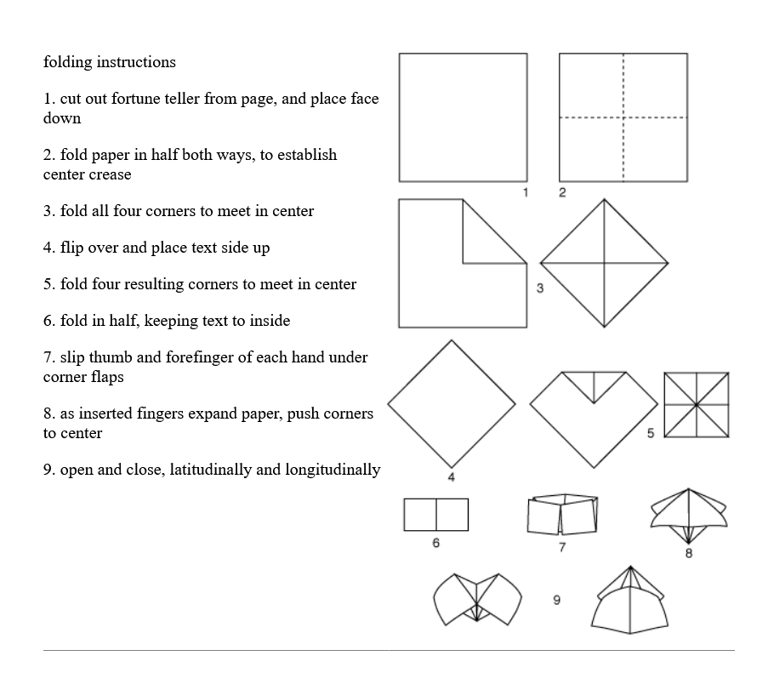
Activity
Make your own ‘fortune teller’ out of paper…

Slide 43
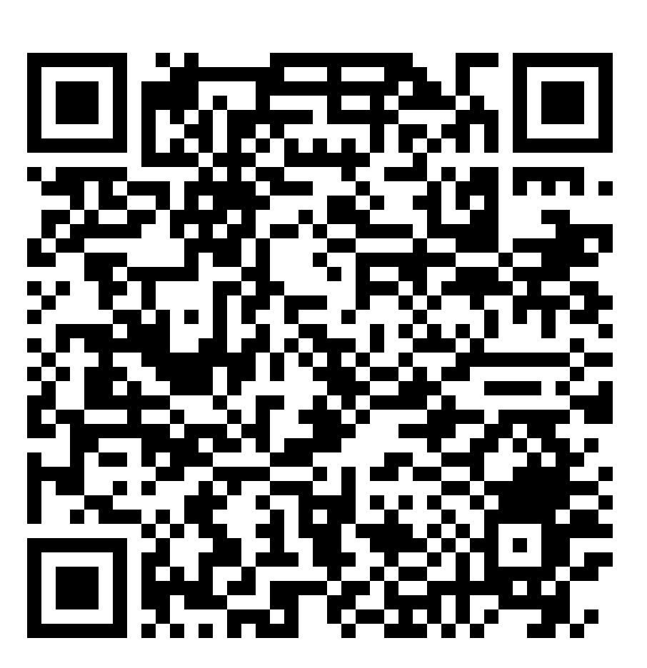
ASCA National Model:
What the Research Says

Slide 44
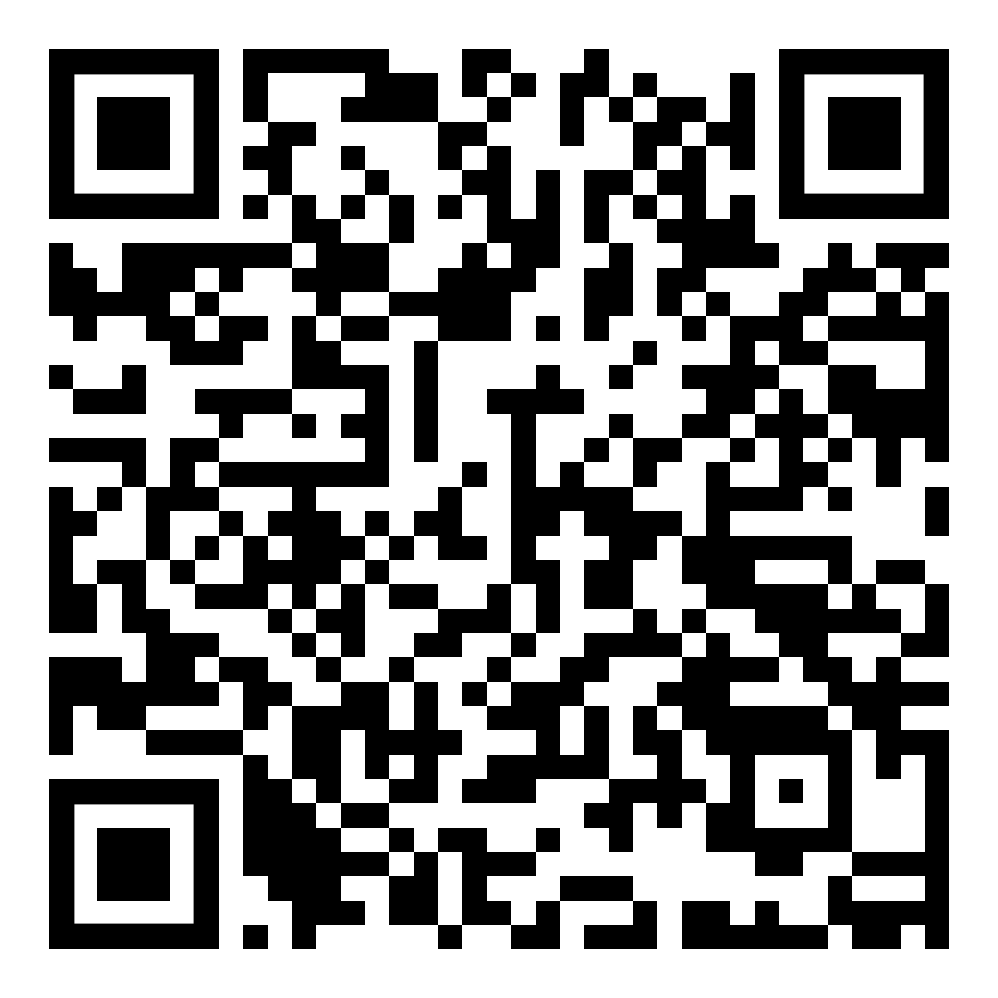
Any Questions?
Scan the QR code to access Evidence-Based School Counseling Research resources.

Slide 45

Any Questions?
Emails for speakers
Jungnam Kim
jungnam.kim@unlv.edu
Chris Wood
chris.wood@unlv.edu

Slide 46
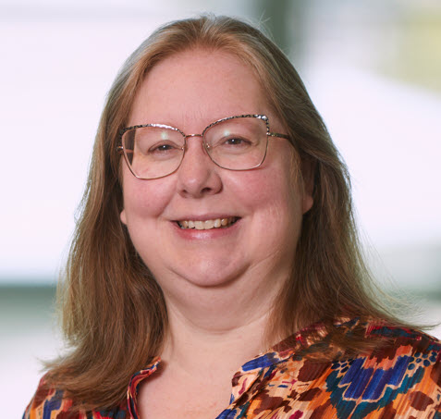
School Psychology
(Kathleen Krach)
S. Kathleen Krach, Ph.D., NCSP is an associate professor in School Psychology at UNLV.
Dr. Krach’s scholarship focuses on the development of culturally appropriate, technology-based, psychological assessments and interventions.

Slide 47

What is a School Psychologist?
Consultation
Research-Based Interventions
Crisis Response
General
Education
Testing and Diagnostics
Special
Education
Program Planning
Counseling as Related Service
Program Evaluations

Slide 48

1: Data-Based Decision Making and Accountability 2: Consultation and Collaboration 3: Interventions and Instructional Support to Develop Academic Skills 4: Interventions and Mental Health Services to Develop Social and Life Skills | 5: School-Wide Practices to Promote Learning 6: Preventive and Responsive Services 7: Family–School Collaboration Services 8: Diversity in Development and Learning 9: Research and Program Evaluation 10: Legal, Ethical, and Professional Practice

Slide 49
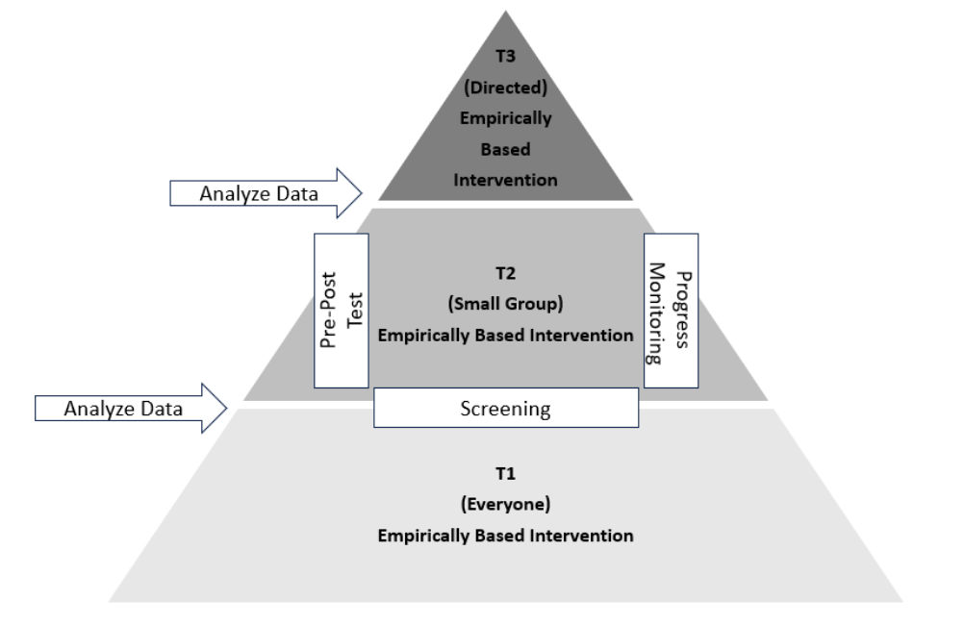
MTSS

Slide 50
Tier 1 Example: Fighting
in the Fifth-Grade Hall

Slide 51
Tier 2 Example: Fighting in
Ms. Jones Fifth-Grade Class

Slide 52
Tier 3 Example: Fighting
by Christal in Ms. Jones Fifth-Grade Class

Slide 53
Assessment: What’s up with Cristal?
Records Data
Report Cards: K-4 no academic issues
Report Cards: K-4 mild conduct probs
Medical: No Vision/Hearing Probs
Medical: Mild Asthma
Demographics: White Female
Demographics: Free/Reduced Lunch
MTSS: Failed to respond to T1 or T2
MTSS: Some response to T3
Interview Data
Mom: Child has no friends
Mom: Child has history of impulsivity.
Teacher: Child has no friends
Teacher: Child is unorganized..
Child: I have no friends.
Child: Kids make fun of me.

Slide 54
Assessment: What’s up with Cristal?
Observation Data
Appearance: Mismatched Items
Appearance: Unfashionable
Hallway: Wanders Aimlessly
Hallway: Avoids Unless Cornered
Class: Sits in the Back
Class: Messy Desk
Class: Needs Redirection to Work
Test Data
IQ: Average
Reading Achievement: Average
Math Achievement: Average
Writing Achievement: Low
Emotional: Social Anxiety High
Behavioral: High Impulsivity
Oppositional: Average

Slide 55
Assessment: What’s up with Cristal?
Hypotheses
ADHD?
Anxiety?
Writing Disability?
Decisions
Special Education?
or Continue MTSS?
What About Middle School?

Slide 56
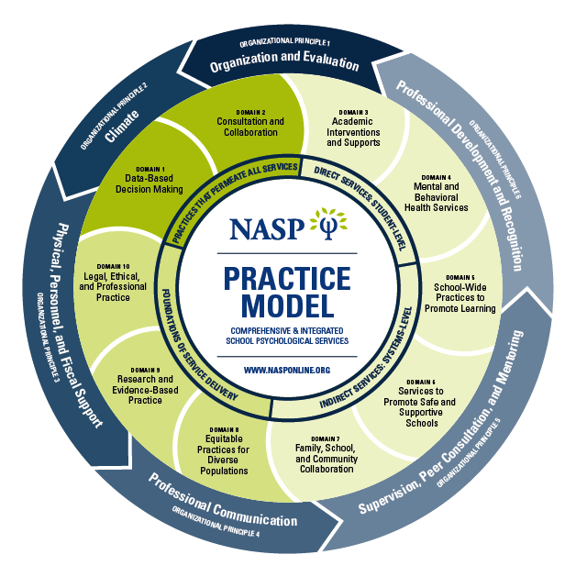
Any Questions?
Contact:
kathleen.krach@unlv.edu

Slide 57
Any Questions?
Email for speaker
S. Kathleen Krach
kathleen.krach@unlv.edu

Slide 58
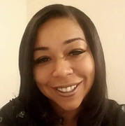
School Social Worker
(La Keshia Walton)
La Keshia Walton, MSW, ACSW, COI is a school social worker at Ruthe Deskin Elementary School.
La Keshia Walton’s expertise spans areas such as medical and mental health, education, children's welfare, leadership, working with marginalized populations, and management. She is also a strong advocate for self-care and mental health awareness, both inside and outside the workplace.

Slide 59
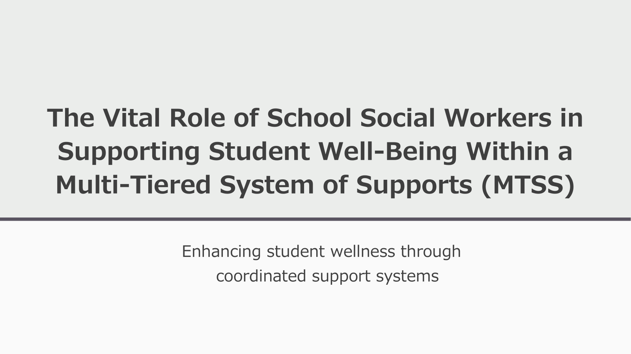

Slide 60


Slide 61
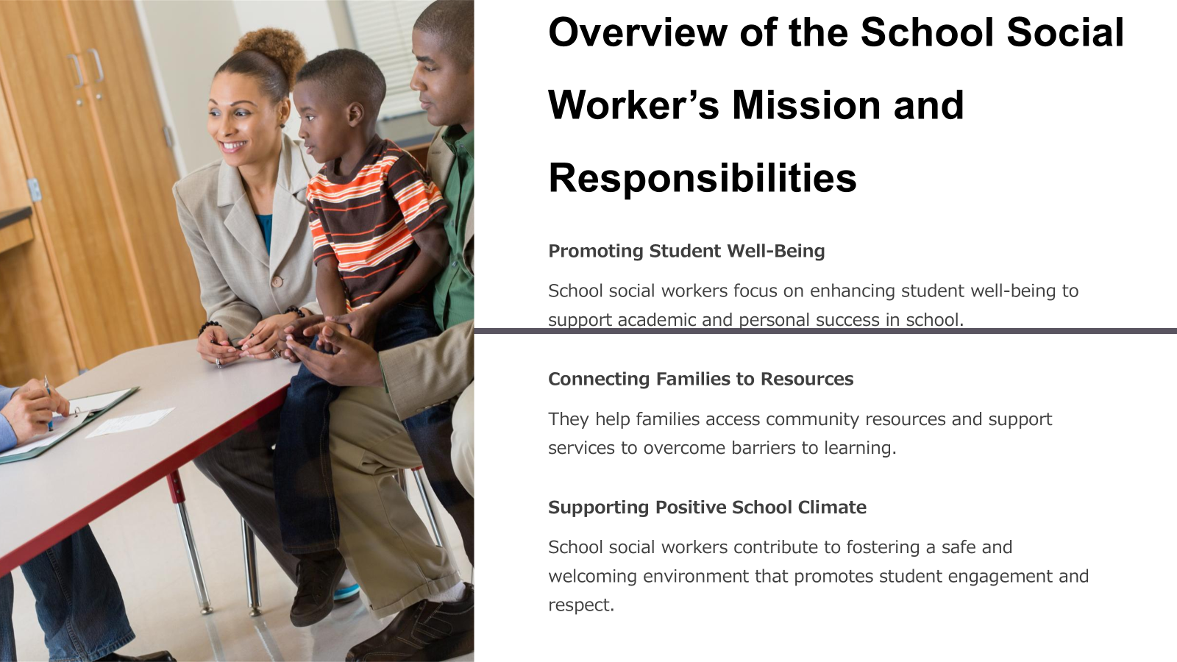

Slide 62
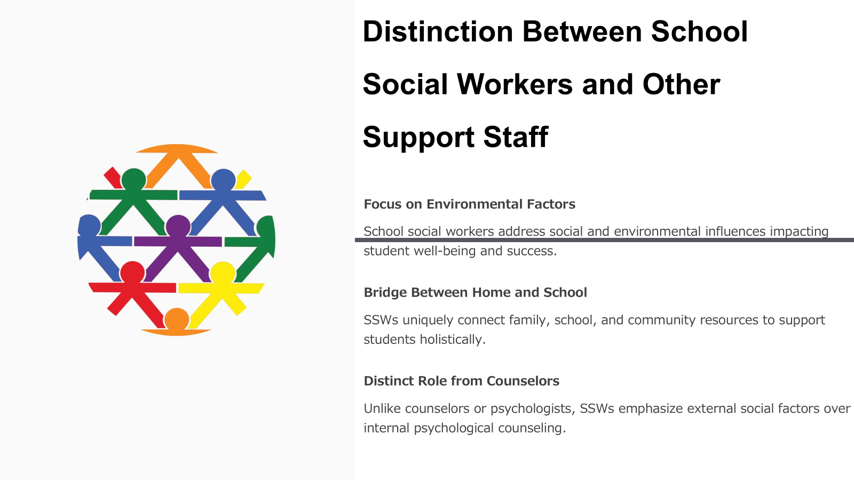

Slide 63


Slide 64


Slide 65
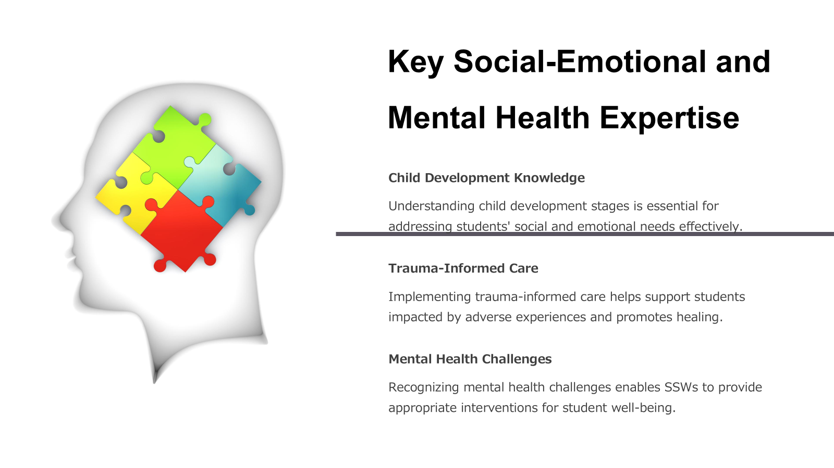

Slide 66


Slide 67


Slide 68
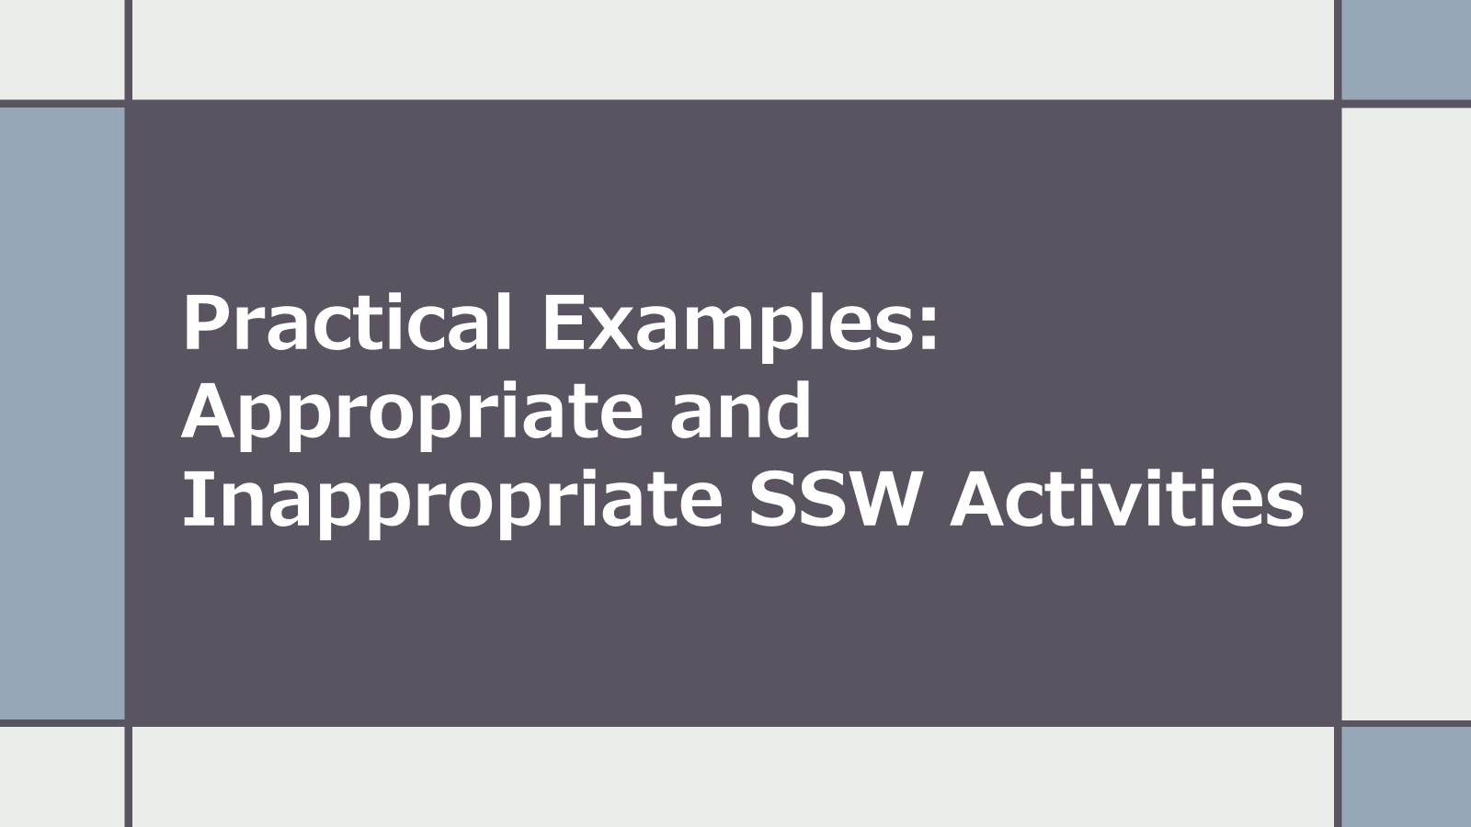

Slide 69
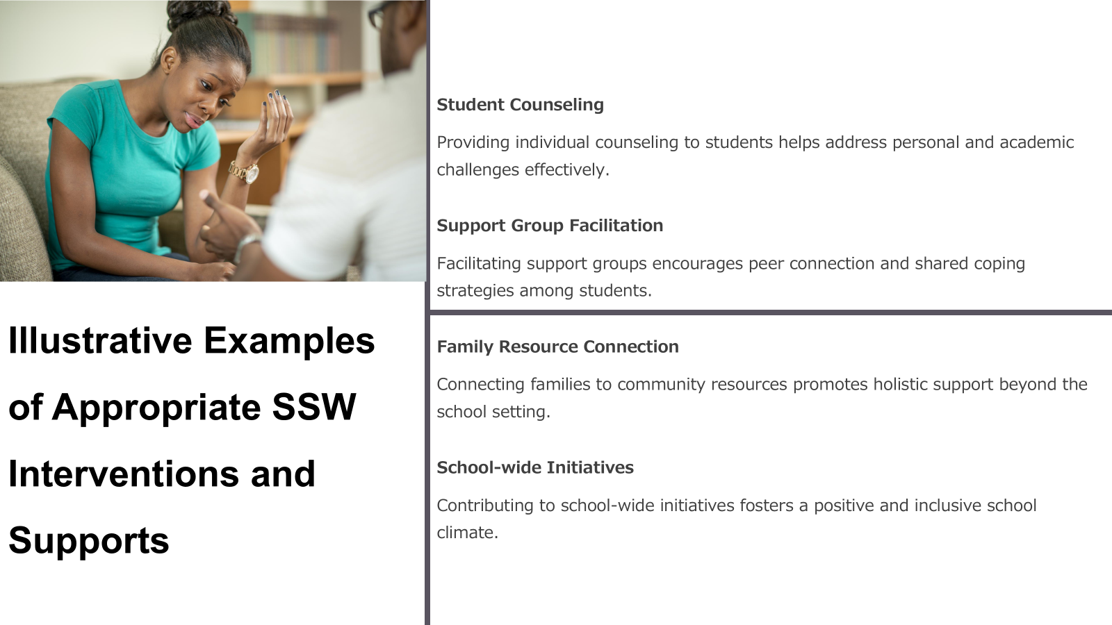

Slide 70
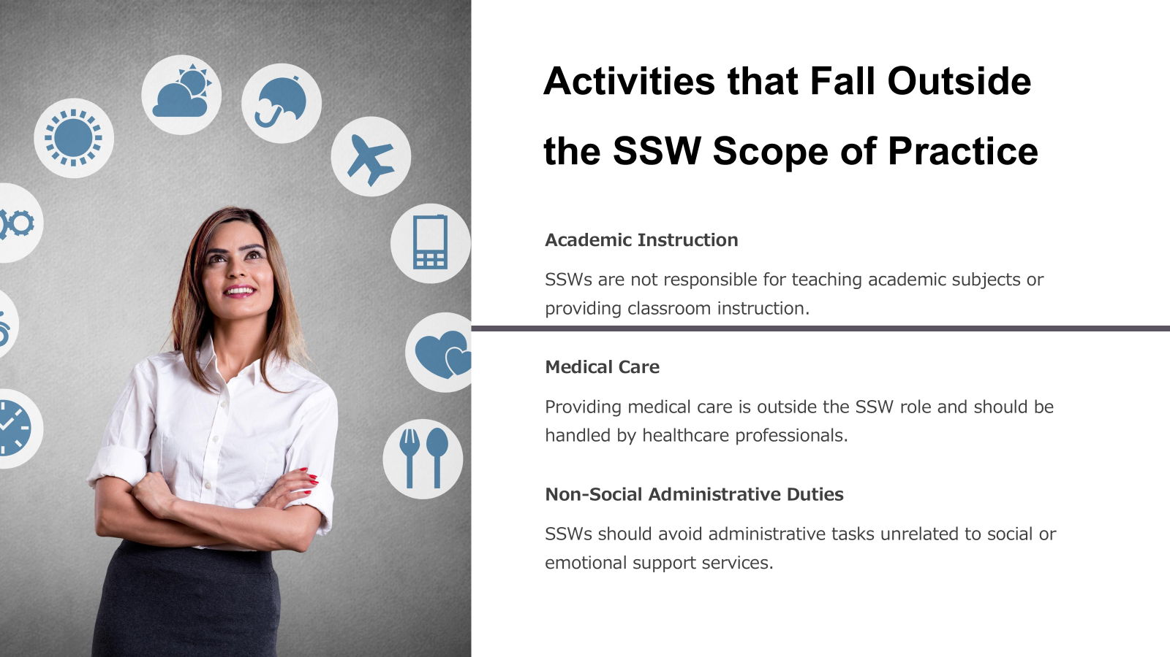

Slide 71
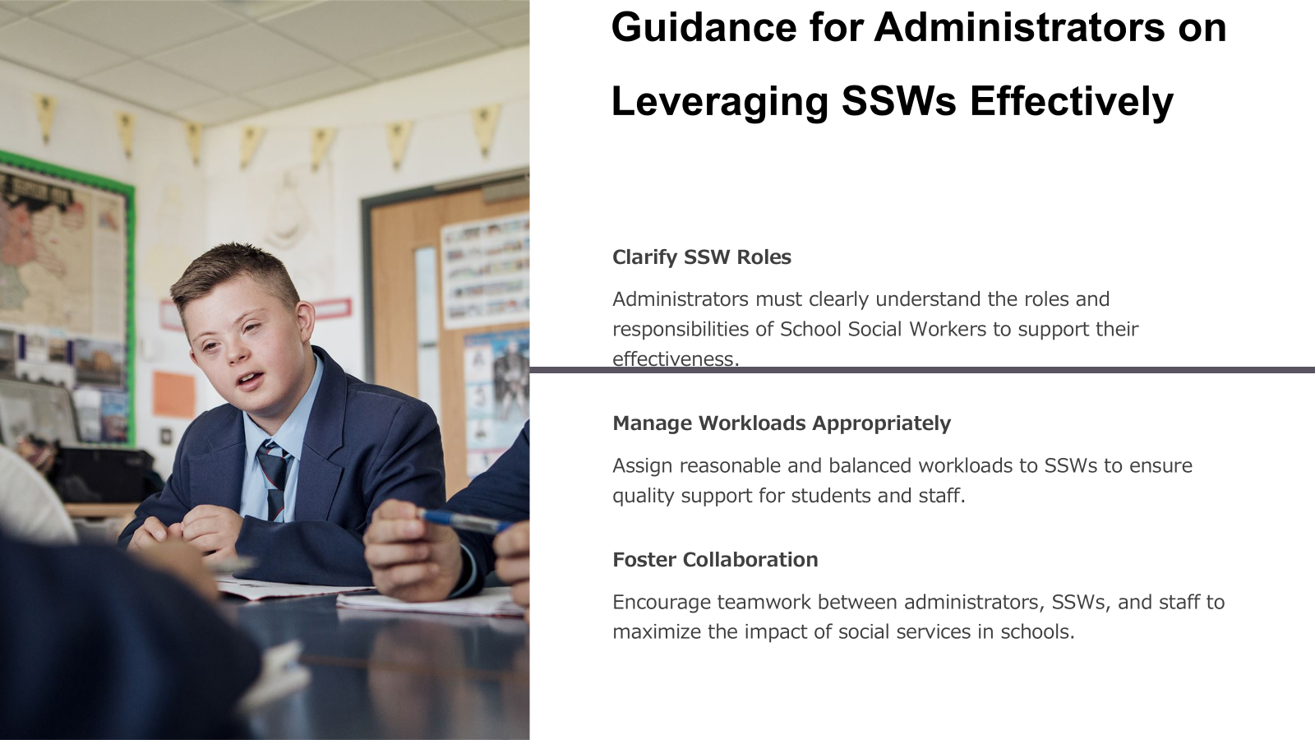

Slide 72
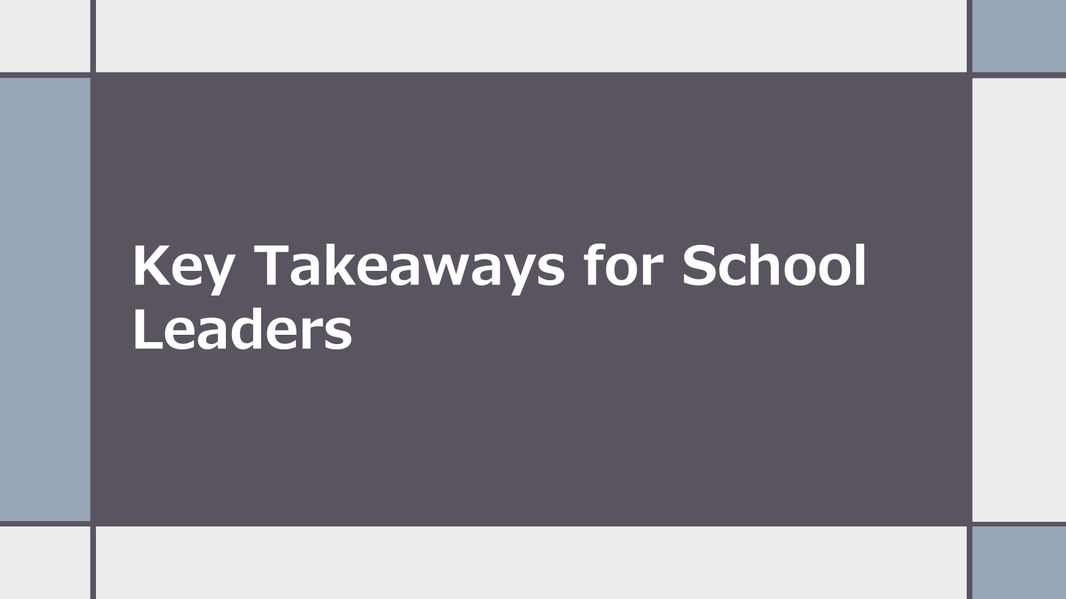

Slide 73


Slide 74


Slide 75


Slide 76
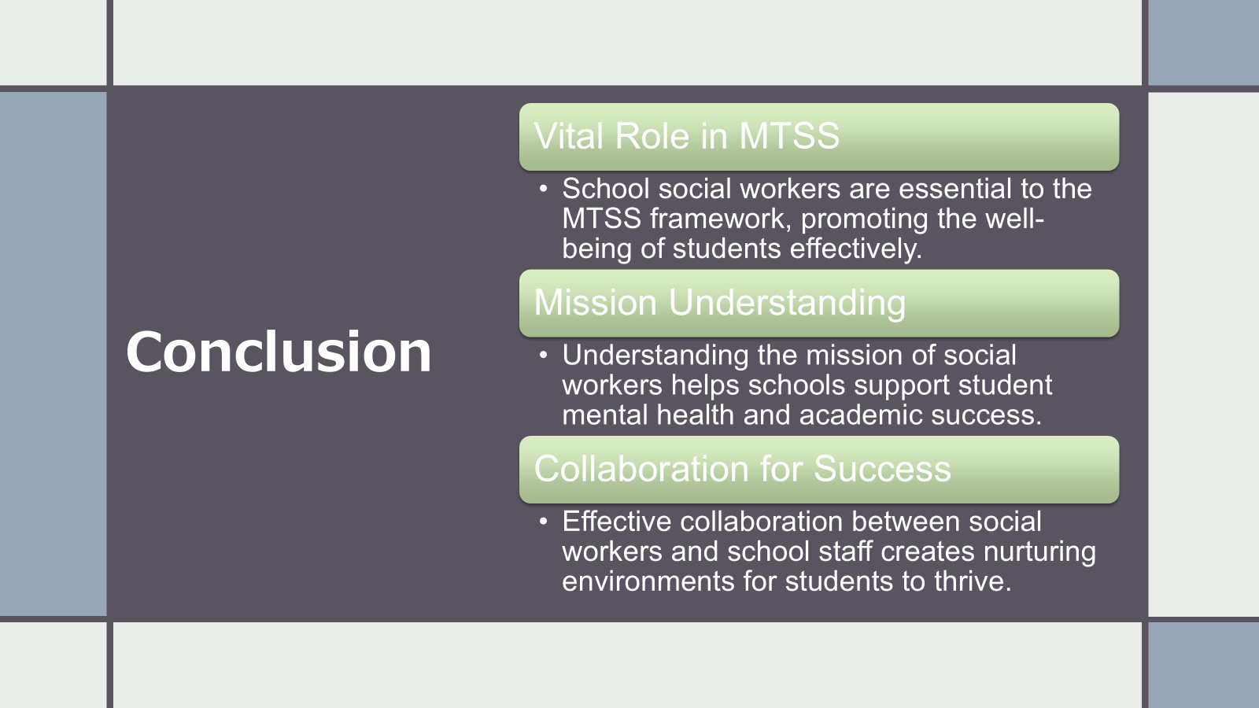

Slide 77
Any Questions?
Email for speaker
La Keshia Walton
waltold@nv.ccsd.net

Slide 78


School Resource Officer
(Mollie Fulwider &
Robert Sperbeck)
Mollie Fulwider is the CCSD Coordinator III, Attendance Enforcement/Shared Housing.
Robert Sperbeck is an Attendance Officer with CCSD
Mollie Fulwider demonstrates a strong commitment to supporting students and guiding them toward positive decision-making and long-term success. She holds a degree in Social Work from (UNLV).
Robert Sperbeck has served in a variety of roles throughout his tenure (started 2002). As an Attendance Officer he demonstrates a strong commitment to community engagement and making a positive impact on the lives of students and their families.

Slide 79
Support and Resources Provided By CCSD Attendance Enforcement
Education Services Division

Slide 80


Slide 81
CHRONIC ABSENTEEISM VERSUS TRUANCY
TRUANCY Counts only unexcused absences. Emphasizes compliance with school rules. Relies on legal and administrative solutions.
CHRONIC ABSENTEEISM Counts all absences: excused, unexcused, and suspensions. Emphasizes academic impact of missed days. Uses community-based, positive strategies.
VS.
Notes:
Chronic absenteeism includes all absences, both excused and unexcused. Truancy is a small portion of chronic absenteeism and is the focus of the Attendance Enforcement Department. Truancy consists of unexcused absences.

Slide 82
Prevention
Clear, consistent messaging
Frequent communication
School-wide incentives and recognition
Family resources
Mentorship and relationship-building
Community partnerships
Notes:
Prevention
Clear, consistent messaging - we have created messaging templates, scripts, infographics through the everyday matters campaign to make sure messaging regarding attendance policies and facts are the same throughout the Clark County School District
Frequent communication - we encourage schools to communicate attendance policies and procedures early and often beginning with their back to school letters information on their websites as well as through the year with reminders in newsletters and seasonal information
School-wide incentives and recognition - we encourage schools to utilize incentives to promote positive and improved attendance, class/grade competitions, etc. to include potential incentives to parents (specifically with younger students) and teachers.
Family resources - we have worked with the municipalities and community stakeholders to create a comprehensive list of resources that are organized and available to families should they need assistance
Mentorship and relationship-building - we encourage schools to utilize mentorship programs for students who have a history of chronic absenteeism as well as recommend that teachers and school staff make personal calls/use personalized messaging to families when communicating about attendance to help build relationships. The goal is to make sure students and families know that they are not just a number and someone does notice when they are not present.
We also work with the community and businesses within the community to raise awareness regarding attendance and have been part of the Go to Grow Coalition which fosters collaboration across community partners and municipalities to provide resources and promote positive attendance.

Slide 83
Incentives
Monthly or quarterly recognition for good attendance or improved attendance (candy, snacks, lunch, prizes, name on wall)
Grade level/class competition for good attendance
Badges or buttons for monthly good attendance
Immediate prizes for targeted student populations (weekly or every few days- stickers, candy, or other recognition)
Monthly or quarterly drawings for prizes
Notes:
Here are some examples of the incentives that we suggest when working with schools. These ideas range from simple recognitions like stickers and buttons to more engaging activities like class competitions or prize drawings. What’s important is that students feel seen and encouraged for their efforts.
As we meet with schools across the district, we’re always listening and learning from what’s working in specific communities. Many of the most successful incentive programs are those that reflect the school’s culture and student interests. We aim to collect and share these ideas to inspire others and promote strategies that are meaningful and achievable for each school. Our philosophy: Prevention first, support always.
We aim to keep students present, engaged, and supported—one day at a time.

Slide 84
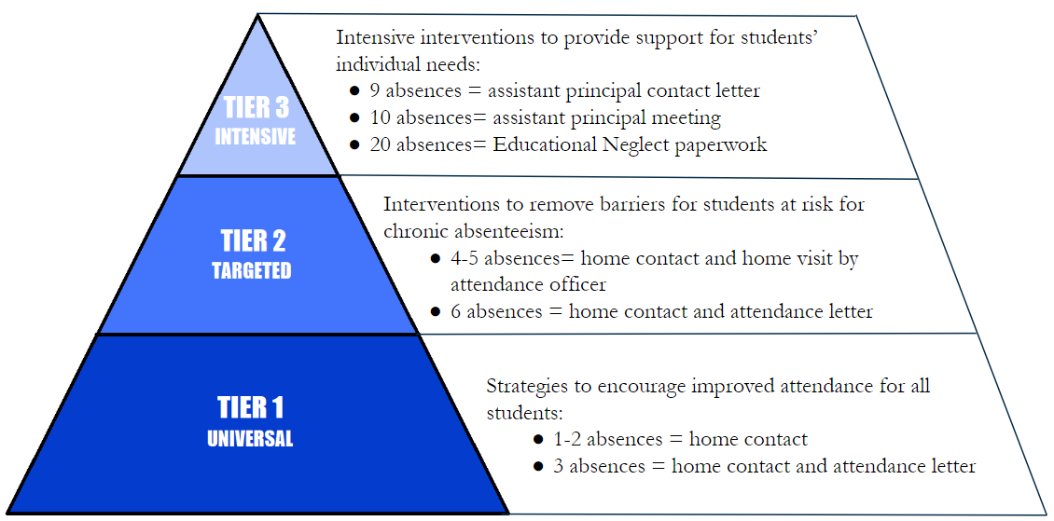
Tiered Interventions
Notes:
Early intervention is key to changing the pattern.
Some other options are attendance contracts, TPOP referrals, etc.
Tiered Systems of Support Tier 1: Universal Prevention
Clear, consistent messaging
Frequent communication
Attendance letters are sent
Phone call home
Tier 2: Targeted Support
Attendance letter sent
Phone call home
Home visit completed by attendance officers
Tier 3: Intensive Support - this is when punitive measures are introduced
Attendance contracts/Individualized incentive plans
Home visit completed by attendance officers
Meeting with administrator and parent
Community referrals (The Harbor, TPOP)
Educational Neglect
Denial of Credit

Slide 85
Services offered by Attendance Enforcement
Attendance Checks/Home Visits
Athletic Address Verifications(received only from Secondary Students Athletics and Activities)
School Refusals (4x per student per school year)
Left Over Transports after 3rd time to YMCA
Truancy Sweeps
Participate in school and community events
Notes:
This slide showcases the on-the-ground work done by Attendance Enforcement Officers. They are key connectors between school and home. Officers conduct home visits to check on students with repeated absences, ensure compliance with address verification for student-athletes, and respond to chronic school refusal cases. They also participate in truancy sweeps and attend local events to increase visibility and build trust within the community.
It's also important to recognize the appropriate and inappropriate boundaries of the Attendance Enforcement Officer role in supporting student well-being and school climate. Officers serve as attendance-focused liaisons—not mental health professionals or disciplinary enforcers. While they may identify issues such as food insecurity, bullying, or mental health concerns during a home visit, their role is to communicate these findings to school staff and request appropriate follow-up from counselors, social workers, or other support personnel.
They are not meant to act as case managers or take over responsibilities that fall under student services. Their presence should reflect a supportive and non-punitive stance—focused on helping students return to school, not enforcing discipline. By staying within these boundaries and working collaboratively with school teams, officers help reinforce a positive school climate and ensure that every student is met with the right level of care.
Officers also share insights gathered during home visits with school staff, including counselors and social workers, to ensure a coordinated response. When officers identify barriers to attendance—such as housing instability, transportation issues, or mental health concerns—they often request support from school-based personnel to address the student's needs holistically.
The Attendance Enforcement Department provides critical support services that help schools lower truancy and improve student engagement. Home visits and attendance checks are a core part of their role and can be requested for students with at least four absences. Officers will visit the student’s primary address listed in Infinite Campus, communicate attendance laws, and encourage contact with the school.
Schools can also request address verifications after a set number of absences to confirm residency. In addition, athletic address verifications can be performed in specific cases where athletic eligibility is in question.
If a student is refusing to attend school, an officer can intervene directly, attempt to engage both parent and student, and even transport the student to school if needed. Officers also respond to repeated incidents of students being left at school by coordinating support after three documented events.
The department also conducts daily morning tardy sweeps around their assigned schools. Officers actively patrol surrounding areas before and during the start of the school day to locate truant students, reroute them to campus, and, when needed, provide transportation. Schools can still submit requests for targeted sweeps through the dispatch office or Attendance Enforcement website if chronic absenteeism concerns persist.
Attendance Officers also build relationships with the community by visiting businesses surrounding schools and encouraging them to call our dispatch line if they find students in their establishment during school hours.

Slide 87

Robert Sperbeck
Clark County School District Attendance Officer

Slide 88
Other Resources for Families
The Harbor - https://theharborlv.com/
  Send referral form via their website
  Assessments completed by student and family to get additional resources such as counseling, classes, or mentorship
Truancy Prevention Outreach Program (TPOP) - https://theharborlv.com/
  Focuses on underlying youth and family needs
  Intensive in-home, in school, and community based services
  Submit referral for students with 7 or more absences
CCSD website - https://everyday.ccsd.net/
  Why Attendance Matters
  Attendance Tips
  CCSD Resources: Family Support Center and Family Engagement Centers
Nevada Family - Go to Grow - https://nvfamily.org
Notes:
In our tiered approach, we rely heavily on school and community partnerships to provide wraparound services. The Harbor is a key referral point for students who need counseling or mentorship. TPOP offers more intensive, hands-on support directly in homes and schools. We also encourage families to access resources through the CCSD website and Family Engagement Centers. Lastly, the 'Go to Grow' initiative helps families across the state with comprehensive tools for improving school attendance.

Slide 89
Any Questions?
Emails for speakers
Mollie Fulwider
goldmm@nv.ccsd.net
Robert Sperbeck
sperbrj@nv.ccsd.net

Slide 90
LUNCH

Slide 91
Morning Afternoon
8:00-8:30 - Breakfast and Intro
9:00-9:40 School Counseling
9:40-10:20 School Psychology
10:20- 11:05 School Social Work
11:05-12:00 School Resource Officer
12-12:30 Lunch
12:30 - 1:30 Focus Groups
1:30 - 3:00 Apply Learning
3:00-3:30 Tips & Takeaways

Slide 92
FOCUS GROUPS
Tell Us More

Slide 93
Brainstorming!
Used provided papers to write down any / all comments related to the question.
Examples:
“We’ve hired a new school social worker every year for the past four years” Or “we have issues keeping our school social worker.”
“All of our school counselors leave to go somewhere else like the elementary school.” OR “we aren’t seen as desirable to school counselors”

Slide 94
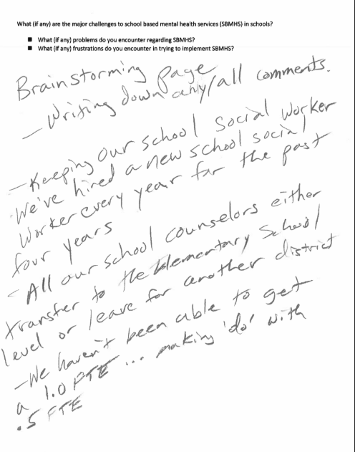
Brainstorming

Slide 95
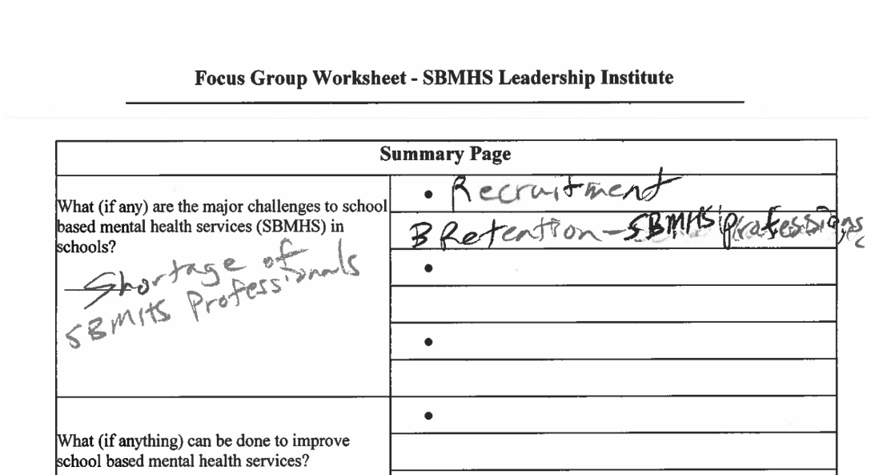
Summarizing

Slide 96
Question 1
What (if any) are the major challenges to school based mental health services (SBMHS) in schools?
– What (if any) problems do you encounter regarding SBMHS?
– What (if any) frustrations do you encounter in trying to implement SBMHS?

Slide 97
Question 2
What (if anything) can be done to improve school based mental health services?
– What (if anything) can districts ‘do’ (policy and/or practice)?
– What (if anything) can the state/federal government ‘do’ (policy and/or practice)?
– What (if anything) can NSHE institutions/higher education ‘do’ (policy and/or practice)?

Slide 98
Question 3
What could be done to honor/appreciate SBMHS professionals in schools?

Slide 99
APPLY WHAT YOU LEARNED
Scenarios for Practice

Slide 100

Scenario 1a
Robert is a Middle School Student in Special Education for an Emotional Disorder and for Other Health Impaired (ADHD). He has a history of bullying, vandalism, and animal abuse.
Ms. Jones, his homeroom teacher, picked up a note that he had dropped by his friend about “snitches get stitches” after he’d gotten in trouble for spray painting the school that weekend.
Ms. Jones looks down and sees Robert’s open backpack. In it is a kitchen knife about 12 inches long. She immediately starts yelling at Robert, and he grabs his bag and runs out of the classroom.
You DON’T know where he is at this time.
The Event
The Individuals

Slide 101
Scenario 1b
You are assigning out tasks:
What do you need to do RIGHT NOW?
  Who should do what?
What needs doing within the next seven days?
  Who should do what?
What needs doing for this child long-term?
  Who should do what?
Assigning Tasks
School Counseling
School Psychology
School Social Work
School Resource Officer

Slide 102
Scenario 2a
There was a school shooting in your state. None of your students, parents, faculty, or staff were involved. But, you have been getting phone calls from parents and the press asking what you plan to do about making sure that this is not a problem in your school.
You have several concerns here: 1) you need to develop a response plan for handling the situation should it arise; 2) you need to evaluate the physical safety / security of the school; 3) you need to conduct a risk assessment on the mental well-being of the school; 4) you need to implement a school violence empathy training program; 5) you need to identify the children at highest risk; 6) you need to provide services to these children; 7) other?
The Event
The Individuals

Slide 103
Scenario 2b
You are assigning out tasks:
What needs doing in Tier 1 (Universal Services)?
  Who should do what?
    Safety Plan
    Risk Assessment (physical)
    Risk Assessment (mental health)
What needs doing in Tier 2 (Targeted Services)?
  Who should do what?
    Empathy Training Program
    Identify Individual Children at Risk
What needs doing in Tier 3 (Direct Services)?
  Who should do what?
    Provide Services to Individuals at Risk
Assigning Tasks
School Counseling
School Psychology
School Social Work
School Resource Officer

Slide 104
TIPS AND
TAKEAWAYS

Slide 105
Post - Evaluation
CEUs
Gift Cards

Slide 106
Special Thanks To
Clark County School District (CCSD)
University of Nevada Las Vegas (UNLV)
Nevada Association of School Administrators (NASA)
School-Based Mental Health Grant (SBMH)

Slide 107
References and Resources
National Association of School Psychologists (NASP; nasponline.org)

